Slide 1
Automatic time tracking software
www.desktime.com

Slide 2
About us
The time tracking app was created for the needs of Draugiem Group
Following the creation, a startup company was founded in 2011 as part of Draugiem Group
A team of 9 is now working together with 10 outsourced marketing and SEO specialists
More than 250’000 users in 209 countries and territories around the world
Automatic time tracking software
www.desktime.com

Slide 3
Our growth
New users
New subscribers
Income
+102%
+40%
+35%
+36%
+23%
+28%
2017
2018
2019
2017
2018
2019
2017
2018
2019
Automatic time tracking software
www.desktime.com

Slide 4
Our median client
A company with 18 employees to track
Located in the USA, India, UK, Canada, Mexico, Philippines, Brazil and Latvia
Subscribes to DeskTime for 15 months
Spends 87% of time at work productively
Automatic time tracking software
www.desktime.com

Slide 5
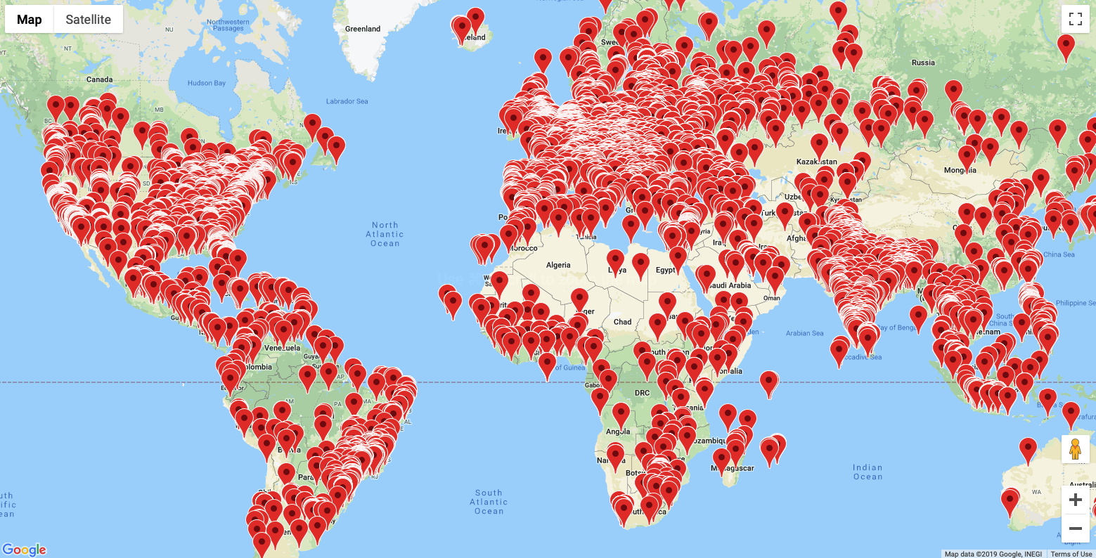
DeskTime on the map
Automatic time tracking software
www.desktime.com

Slide 6
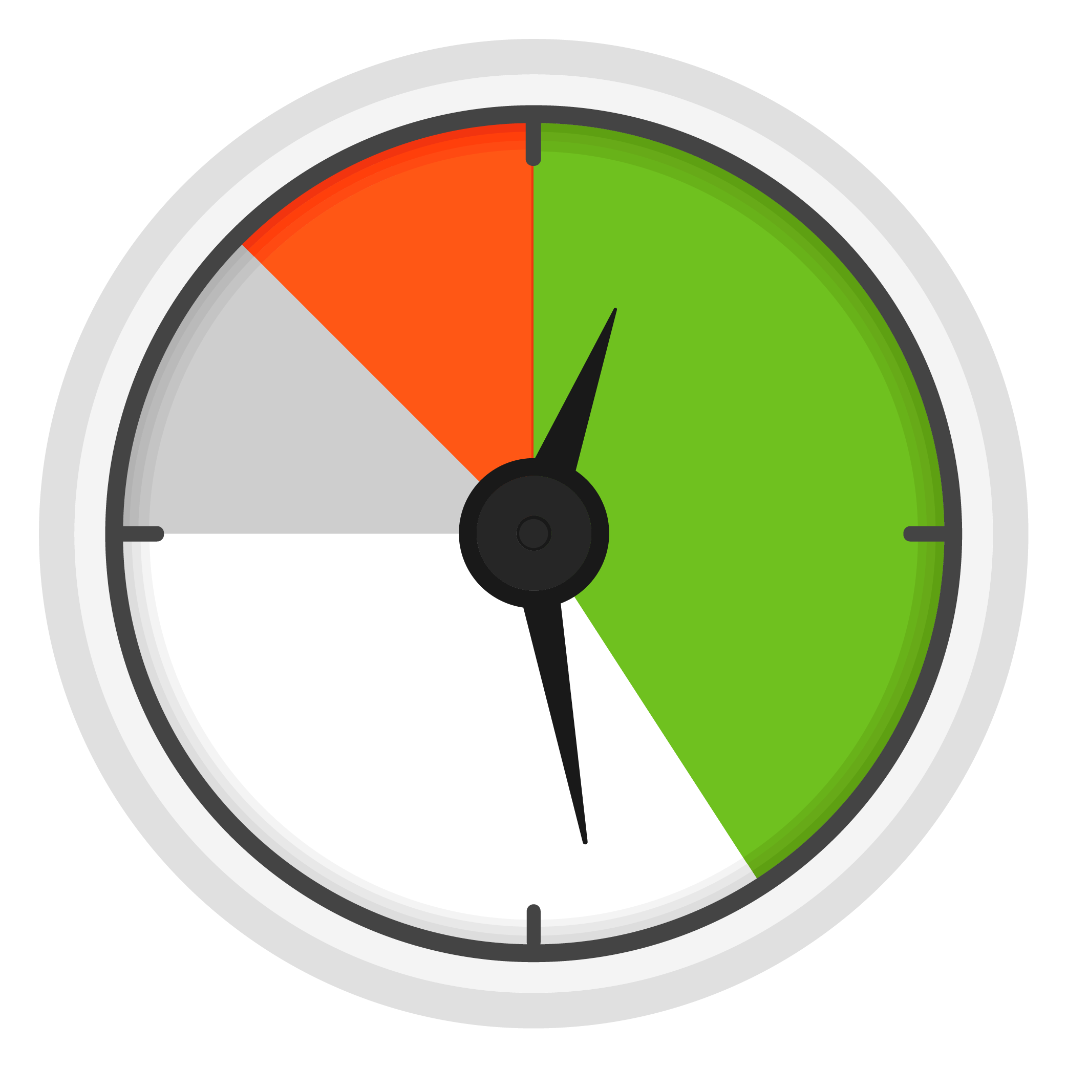
Why track employee time?
Statistics show that only 59% of office time is spent on work related tasks
On average, 20%* of all office time is spent Unproductively
In the EU tracking employee working hours is obligatory since 2019
*That’s 4 workdays a month, 48 workdays a year
Automatic time tracking software
www.desktime.com

Slide 7
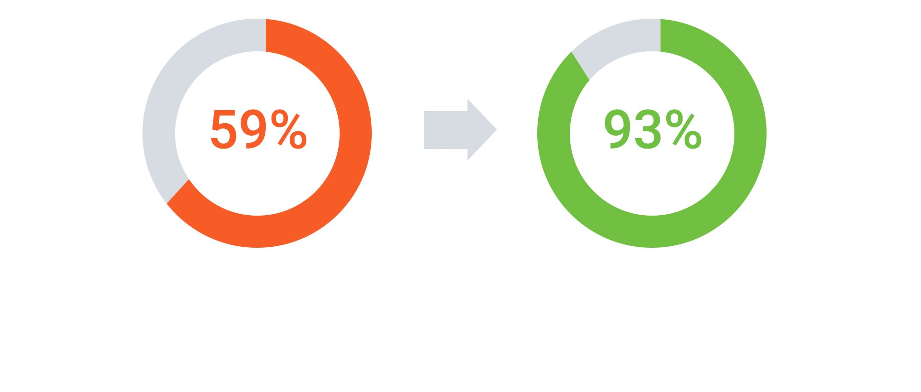
Employee productivity before DeskTime
Employee productivity using DeskTime
Automatic time tracking software
www.desktime.com

Slide 8
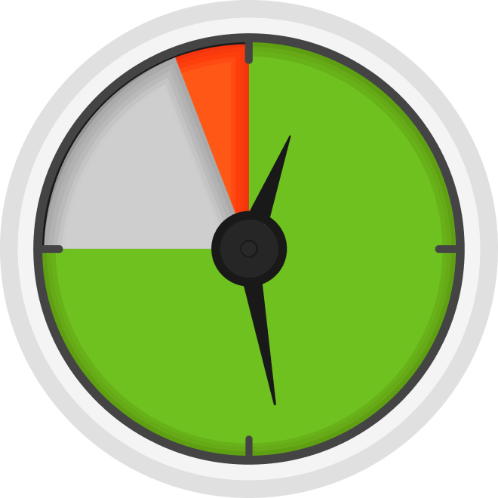
About the software
Tracks employee working hours and used apps to reduce wasted time at work.
Divides work into productive and unproductive activities
Designed to help employees increase their own performance, as the personal results are visible to the employee as well
Automatic time tracking software
www.desktime.com

Slide 9
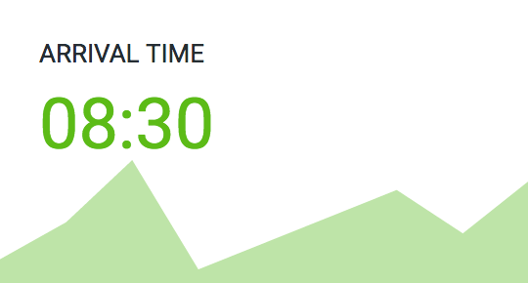
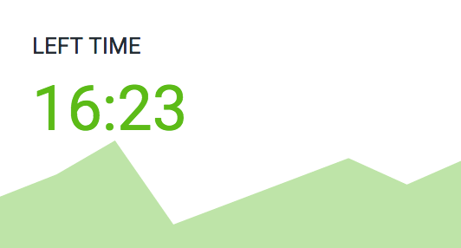
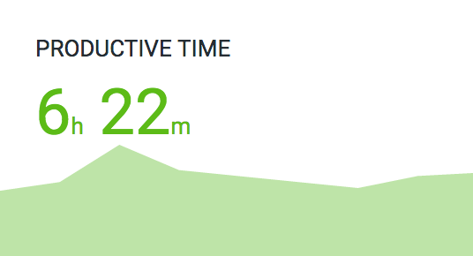
Time tracking
Arrival and leaving times
Productive office time
Total time at the computer
Total time at work
Employee effectiveness
Automatic time tracking software
www.desktime.com

Slide 10
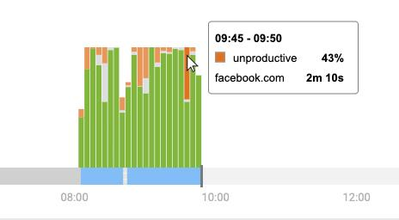
Productivity tracking
Shows the employee’s day on a timeline
Tracks where their time was wasted
Gathers data on breaks and lunchtimes
Automatic time tracking software
www.desktime.com

Slide 11
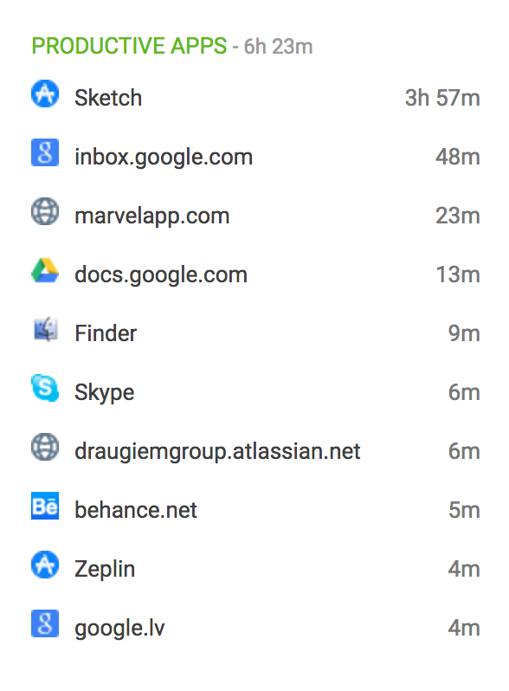
App and document tracking
DeskTime tracks what websites, apps and programs the employee has used throughout the day
Document names and website URL’s can also be tracked, if necessary.
An admin can change the productivity status of each app, which allows them to measure employee work productivity and effectiveness
Automatic time tracking software
www.desktime.com

Slide 12
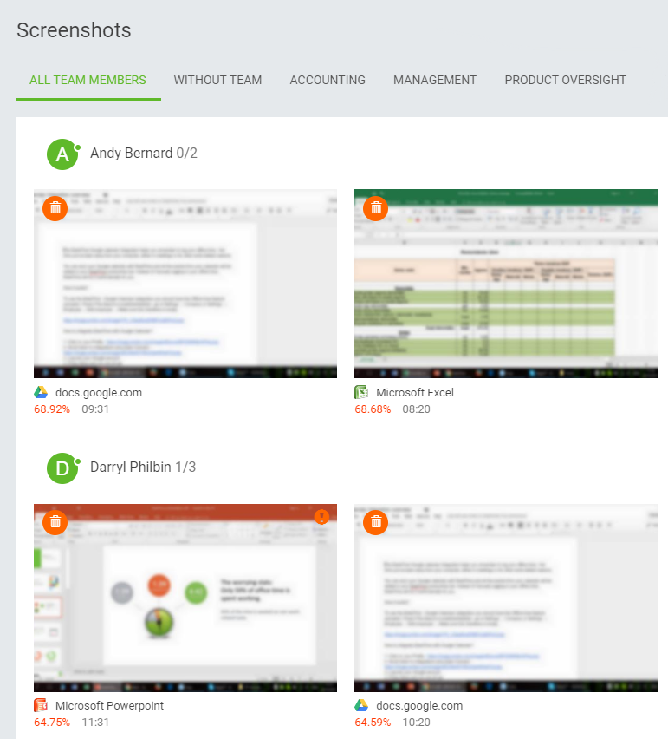
Automatic screenshots
As an optional feature, screenshots can be turned on to be taken automatically – blurred or in full quality.
DeskTime captures screenshots in random 5, 10, 15 or 30 minute intervals.
Automatic time tracking software
www.desktime.com

Slide 13
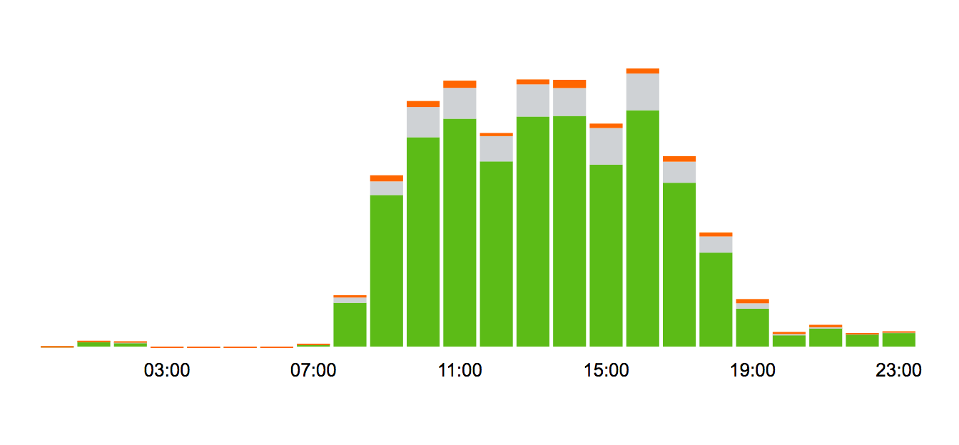
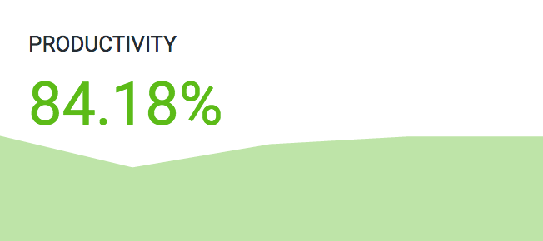
Admin dashboard
Shows the average productivity of all employees
Provides details on how many employees are absent and how many were late today
Shows real-time information on how many employees are being productive and how many are not.
Automatic time tracking software
www.desktime.com

Slide 14
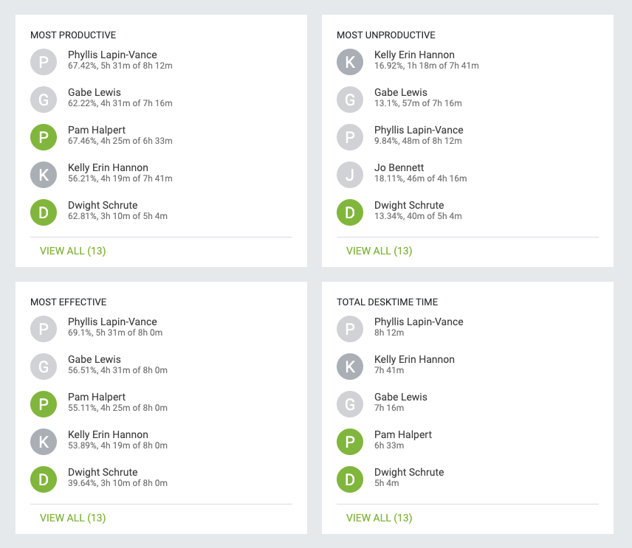
Admin dashboard
Shows most productive and most effective employees
Lists how much offline time has been logged
Provides details on how much time employees were late
Automatic time tracking software
www.desktime.com

Slide 15
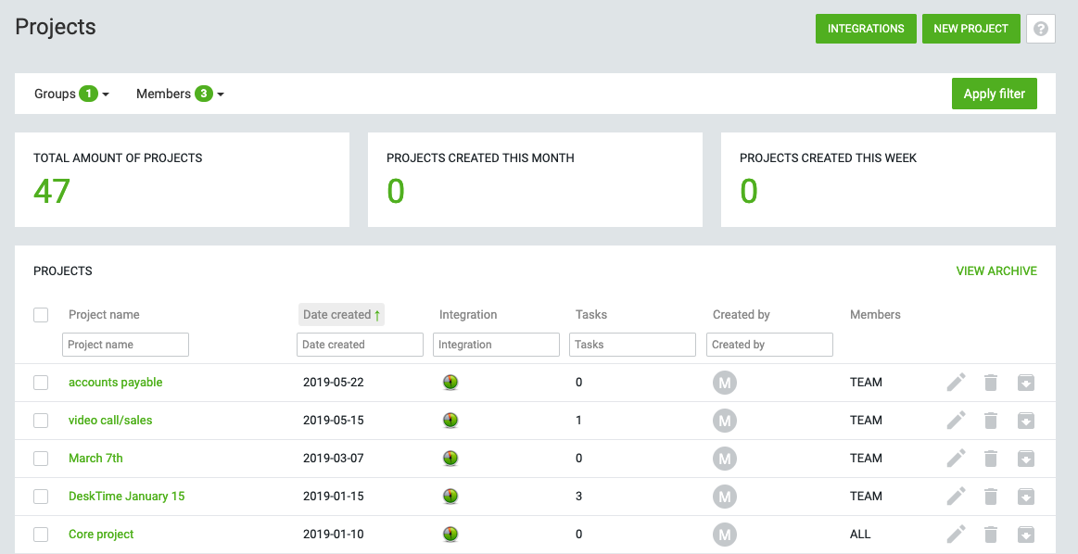
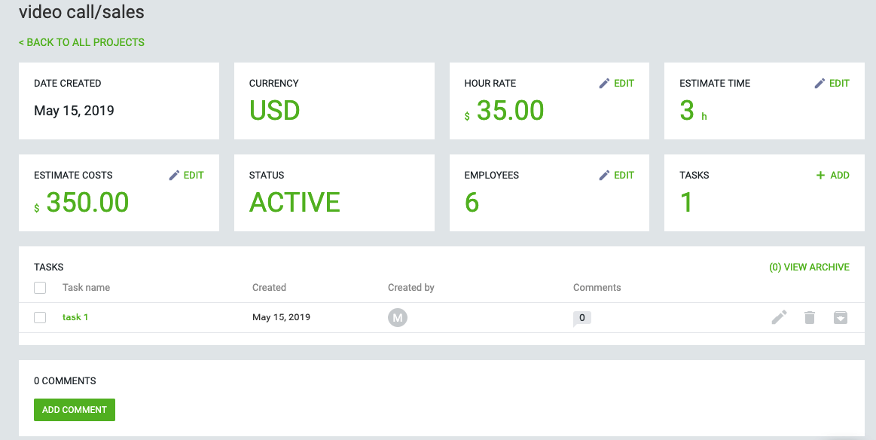
Project tracking
Tracked time can be assigned to specific projects and tasks
Admins can see who is working on which projects and tasks, as well as how much they cost to the company.
DeskTime can be integrated with Asana, Jira, Trello and others to track time to the integrated projects.
Automatic time tracking software
www.desktime.com

Slide 16
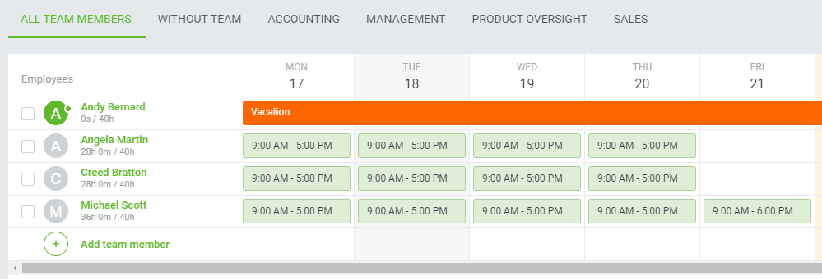
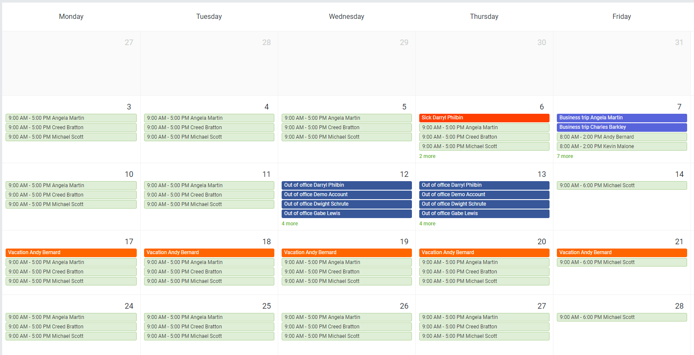
Work schedules
DeskTime can be used to plan employee shifts and specific working times
Allows the planning of night shifts and multiple shifts a day
Shows employees when their teammates will be at work
Automatic time tracking software
www.desktime.com

Slide 17
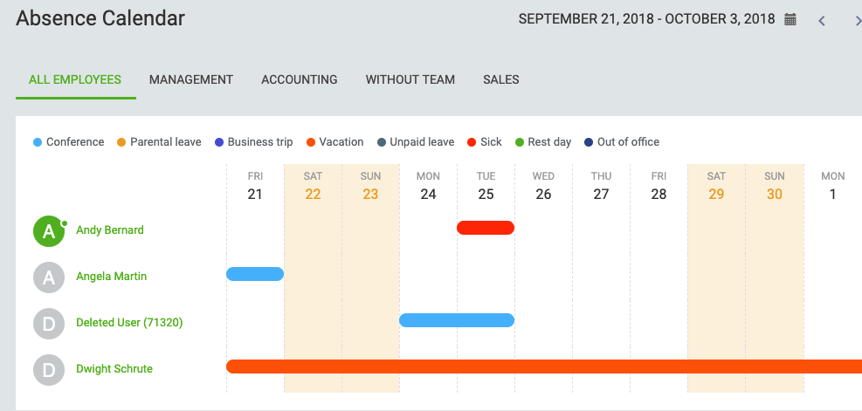
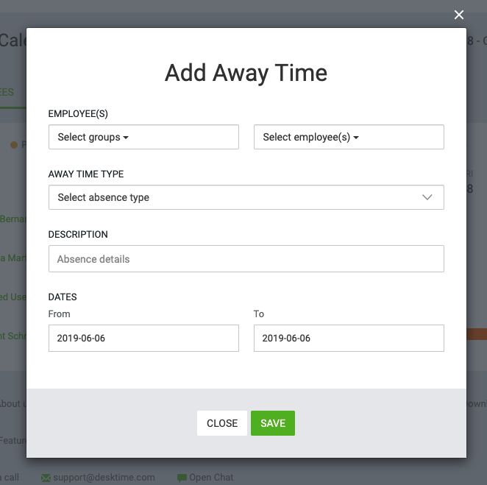
Absence calendar
The absence calendar gives an option to plan vacation days, business trips, etc., as well as enter sick days for employees.
Employees can request vacation times, which can be approved or declined by managers.
In reports, see how many vacation days each employee has had
Automatic time tracking software
www.desktime.com

Slide 18
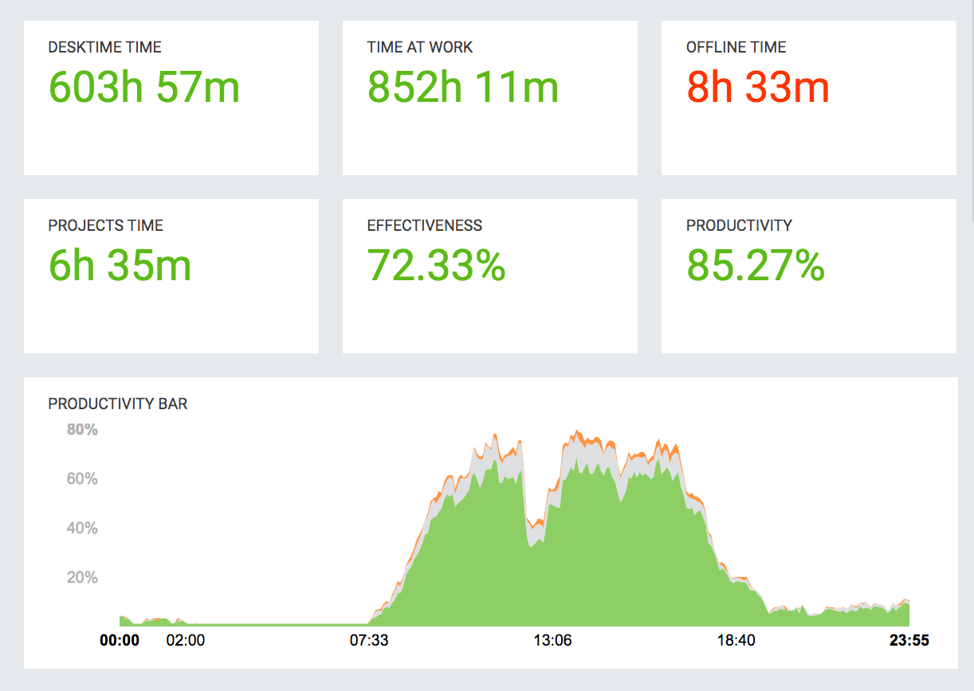
Reports
Shows the tracked data organized by days, weeks or months
A filter option allows secluding only the relevant information
The data can be exported as Excel files ready for calculations or company reports
Automatic time tracking software
www.desktime.com

Slide 19
Boost productivity
Stay organized
Save time
Automatic time tracking software
www.desktime.com

